Slide 1

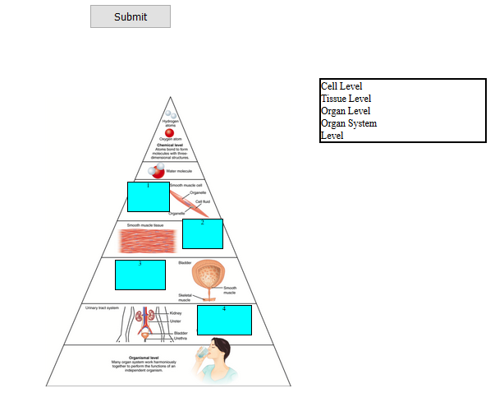
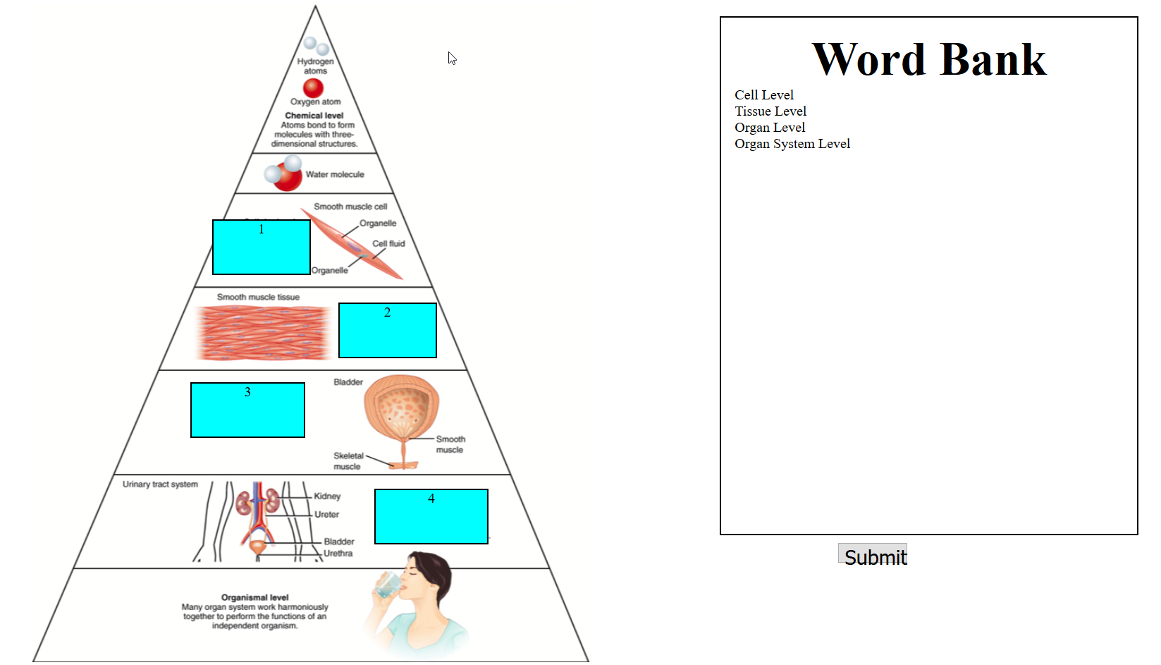
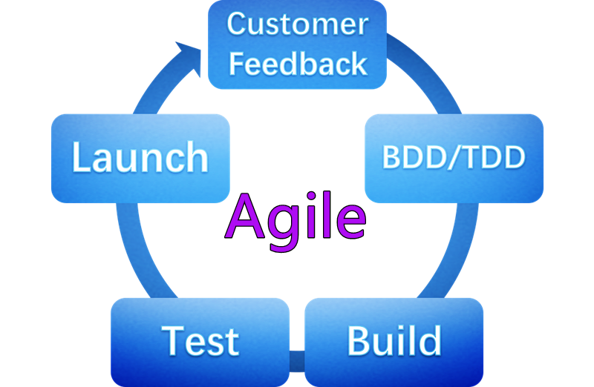
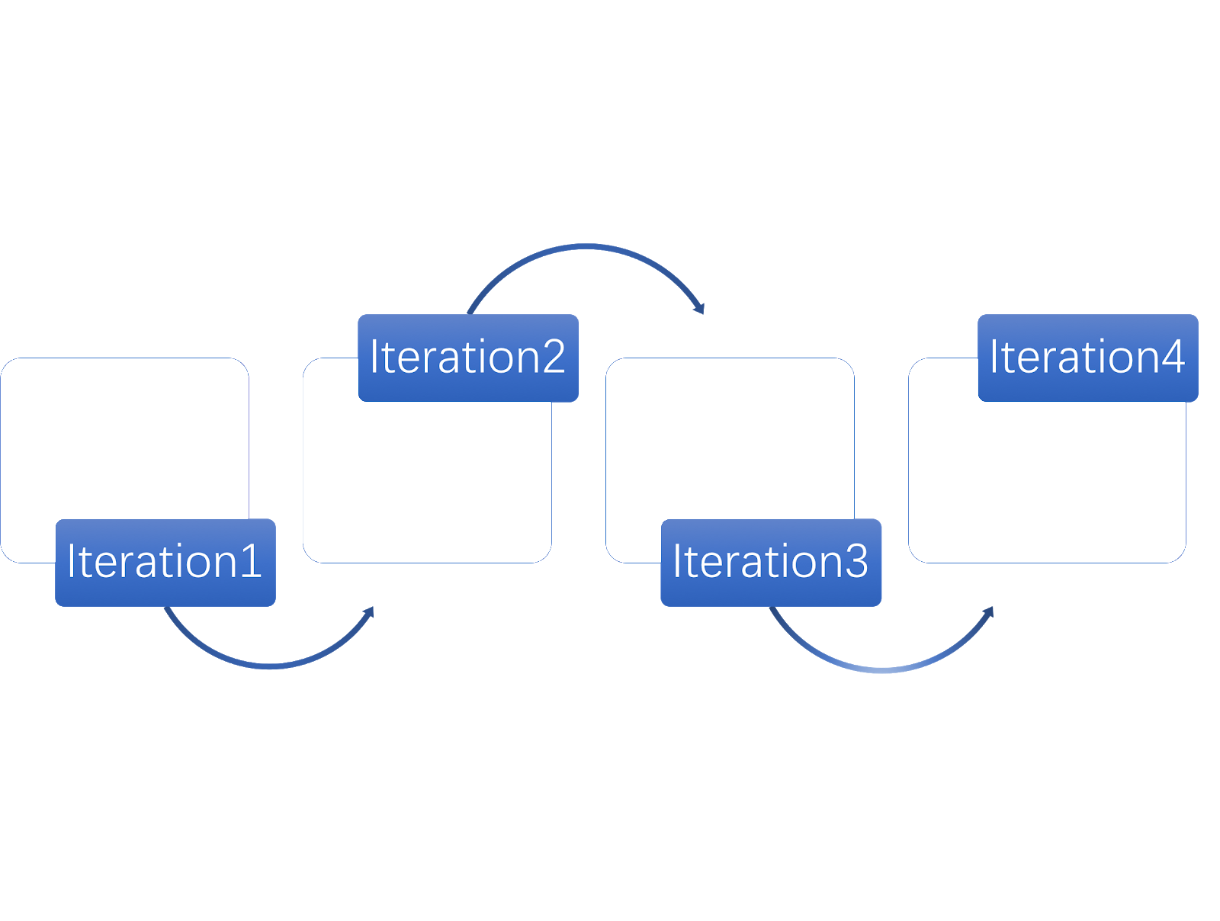
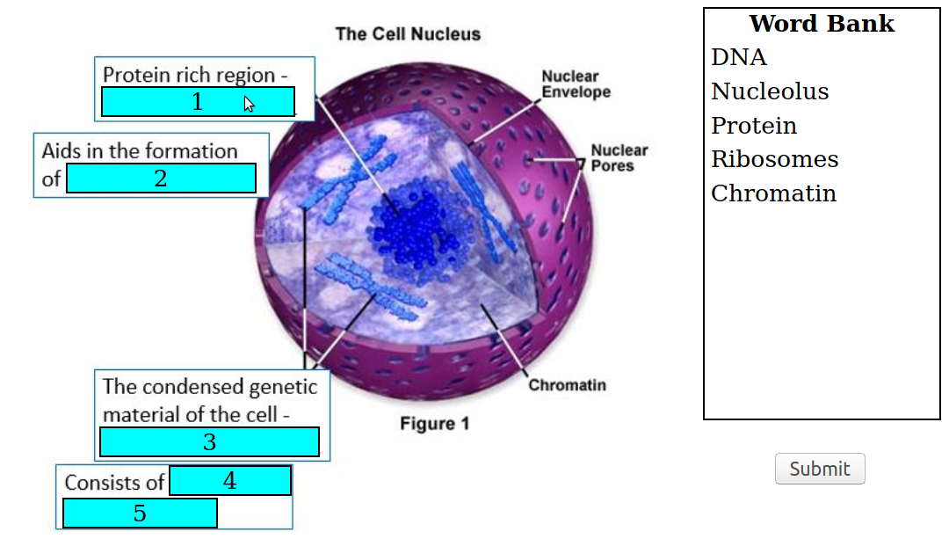
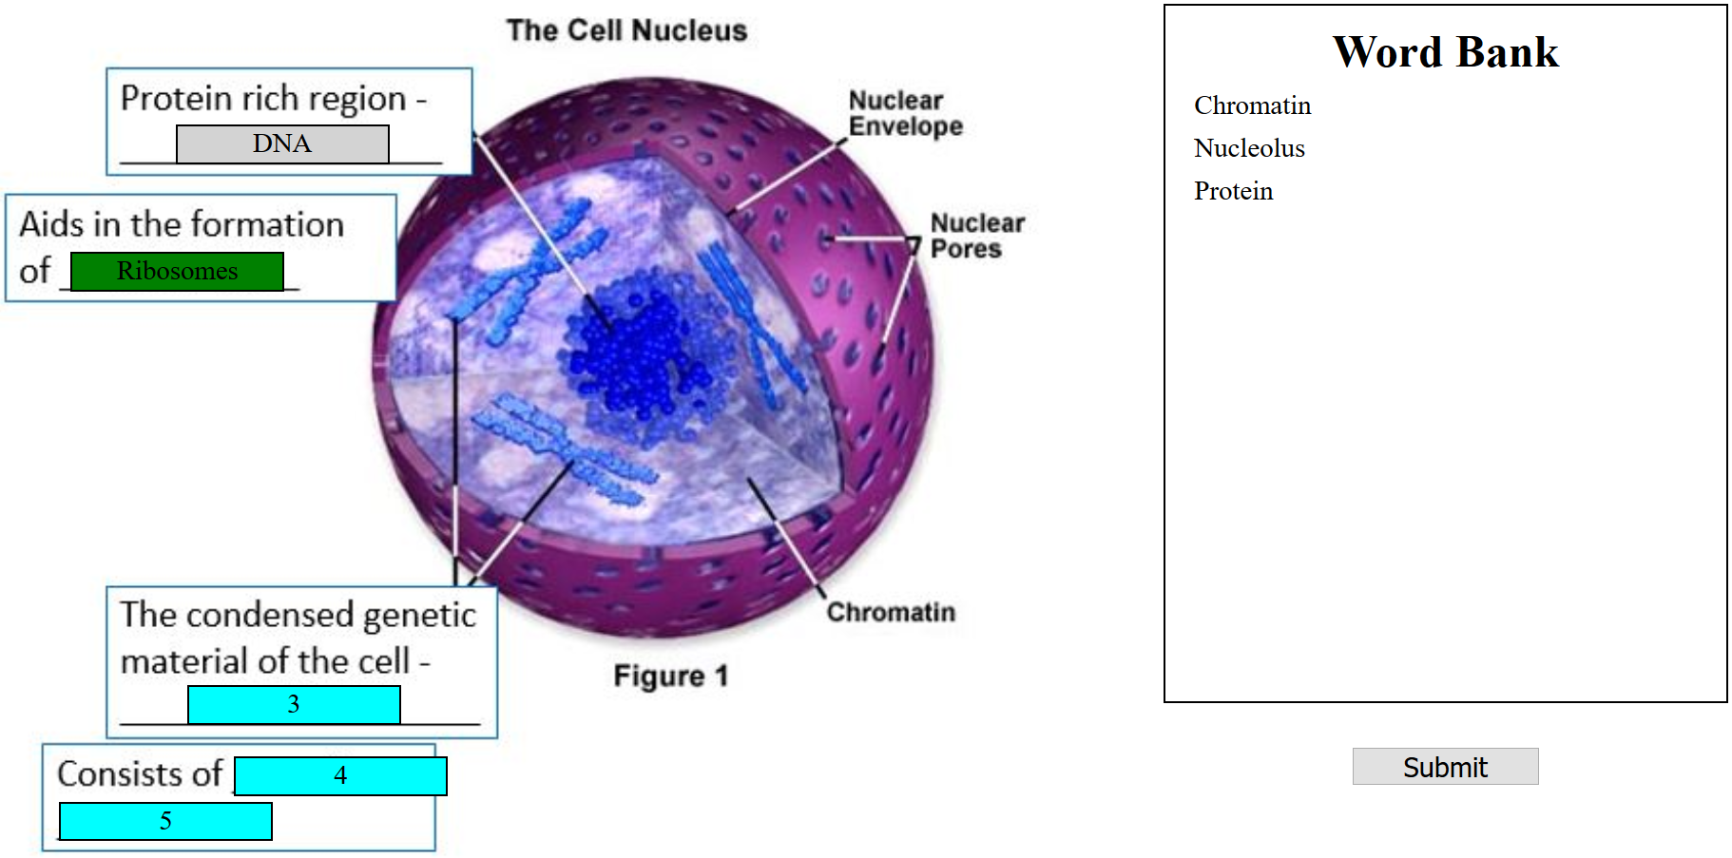
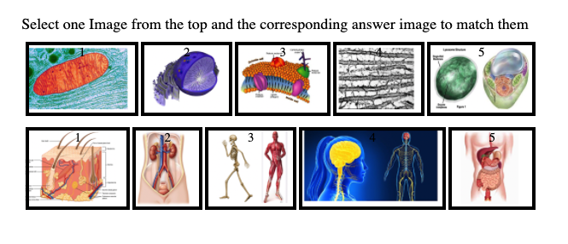
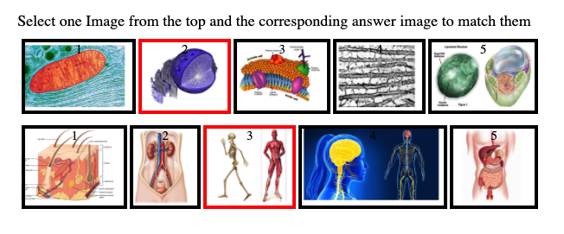
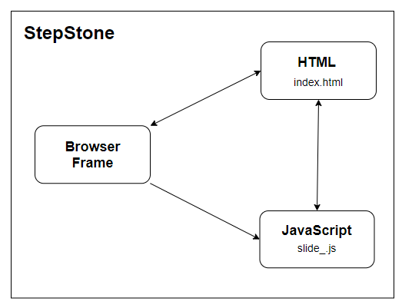
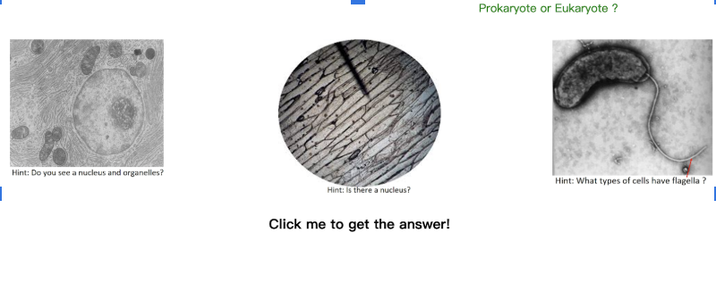
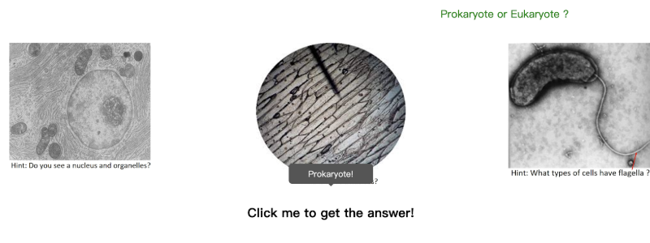
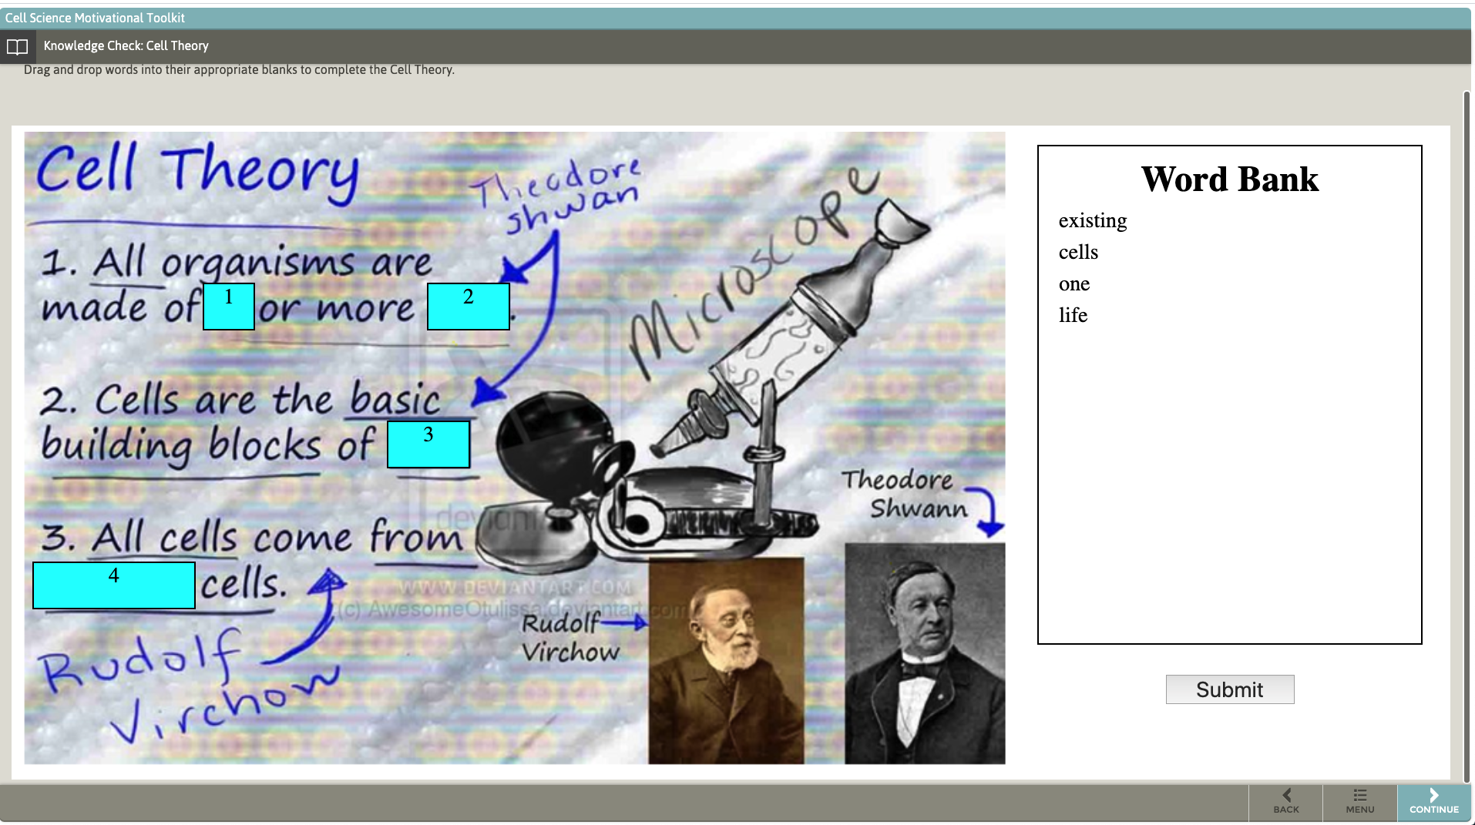
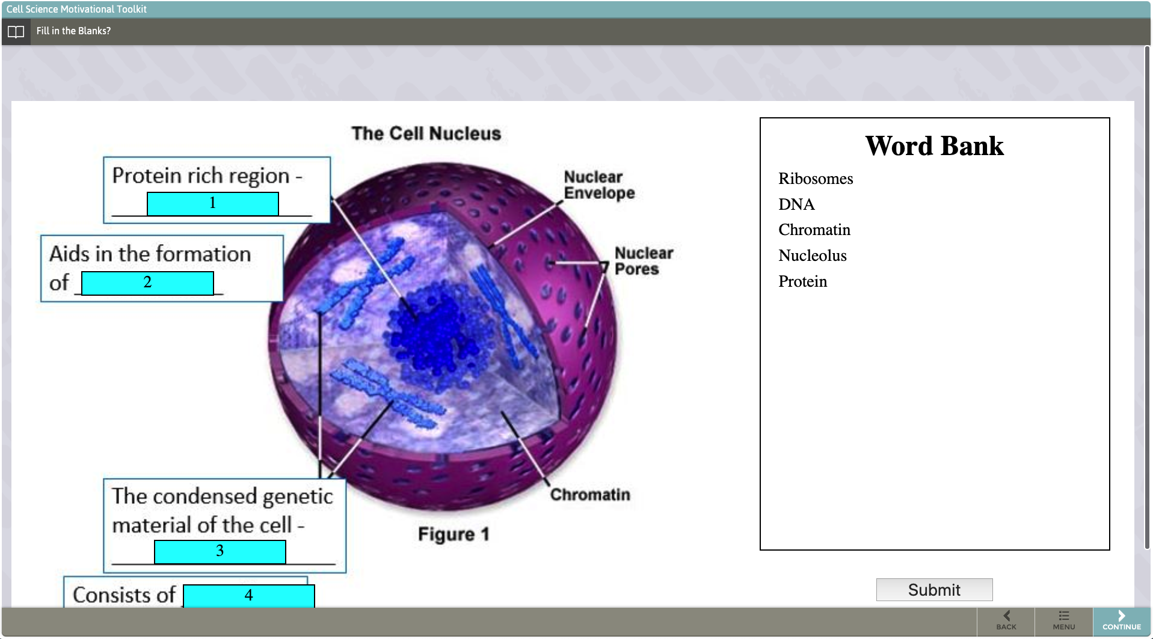
Animation in Cell Biology Learning Content
Sri Charan Challa, Hao Yu Miao, Kunping Huang, Chiou-Jiin Huang, Han-Hsien Huang, Ming-Hsien Chien
Dept. of Computer Science and Engineering, Texas A&M University
have
Introduction
Legacy Project
Our team updated the front-end of a legacy project
Frontend is Ajax based with HTML, CSS, and jQuery
Application is deployed on StepStone.
We implemented new features in three types of slides: Drag and drop slides, Matching slides and Clicking slides.
The previous group has designed some interactive slides for the biology department.
In this project, our team fixed some errors of the legacy project and improved functionalities and aesthetics.
Agile Workflow
Slides
Drag and drop slides highlight their main features. The answer fills in the question box, the correct answer is green, and the wrong answer is a different color.,
Created user stories
Split project into 3 parts
Assigned people to each part
Each person finished one slide
Discussed future plans
Finished remaining user stories
Looked into StepStone deployment
Deployed slides to StepStone
Testing
Matching slide has six features. The figure below shows that two images turn red when we click two unmatching images.
Overall Diagram
The project is ran on StepStone, which is has limited internet access, so the diagram is simple
The Clicking slide reveals the answer after clicking on it.
StepStone Deployment
Summary
This project was worked on by a team of 6, including a scrum master and a product owner.
We started by splitting up the project into 3 parts and created subgroups, each assigned to one part. Each subgroup came up with their own user stories and started working to update the legacy project. After every group was finished, we uploaded everything to stepStone and started testing in that environment.
We successfully deployed our updated code to the StepStone environment.
We had to use the legacy team’s i-frame resizer to display the slides properly

